Slide 1

Level-Up Learning
Transfer Learning-based Policy Generalization in Platforming Video Games
Joseph Kawiecki and John Ramthun

Slide 2
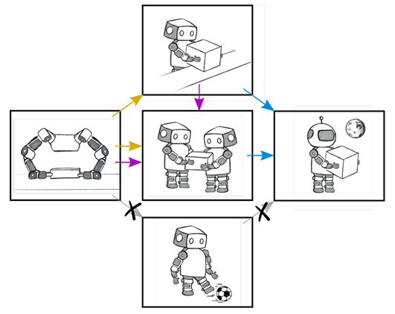
Motivation & Background
Transfer learning enables greater efficiency, effectiveness
Transfer Learning
Deep Q-learning (DQN)
Advantage Actor-Critic (A2C)
Proximal Policy Optimization (PPO)

Slide 3
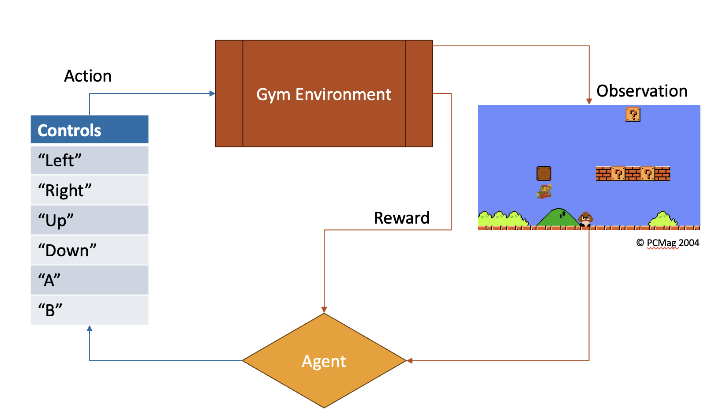

Super Mario Bros as an MDP
MDP – (S, µ, A, P, R, γ):
S: State space - Game Frames
µ: Initial state distribution - Save States
A: Action space - Controls (combinatory)
P: Transition function - What actions can be taken in each state?
R: Reward function - Feedback from the Env
Moving in the right direction?
Collecting in-game rewards?
Wasting time?
γ: Discount factor
Notes:
Let's examine our environment. We trained agents to play Super Mario Bros. from the NES using Gym Retro. To appropriately contextualize this, we need to consider the game in the context of Markov Decision Processes, as defined here.

Slide 4
Methodology - Base Models
Baseline agents on 1-1, 2-1, 3-1, 4-1, 8-1
3M time steps total
3k steps per epoch
Reward: ∆x + ∆score - time + 200 * ( using warp pipe )
Issues:
Agent learned that dying is good → Close loophole
Agent gets stuck → positive or negative reward?
Agent acts inhuman → What reward matches the human experienced reward?
Notes:
Let's establish our methodology. First, we trained five baseline agents on the listed levels to determine a performance target.
Each agent had 3M total steps to optimize the policy via PPO. They were also limited to 3k steps per epoch to force the model to optimize rather than purely explore
The reward function we chose is the positive change in horizontal position + the positive change in score - one point per second + 200 pts for using L-shaped warp pipes. This function aims to solve the following issues

Slide 5
Methodology - Transfer Learning
Pre-training & Policy Transfer Approaches
Take a base model (trained on 1-1) and use that to initialize a new model
PPO keeps the previous experiences and policy
Take a base model and transfer the policy to a new model
PPO loses previous experience but keeps policy
Multi-Task Inspired Approaches
Agent 1: Sees a random level after every episode terminates
Agent 2: Sees all eight levels at the same time
Test with various learning rates

Slide 6
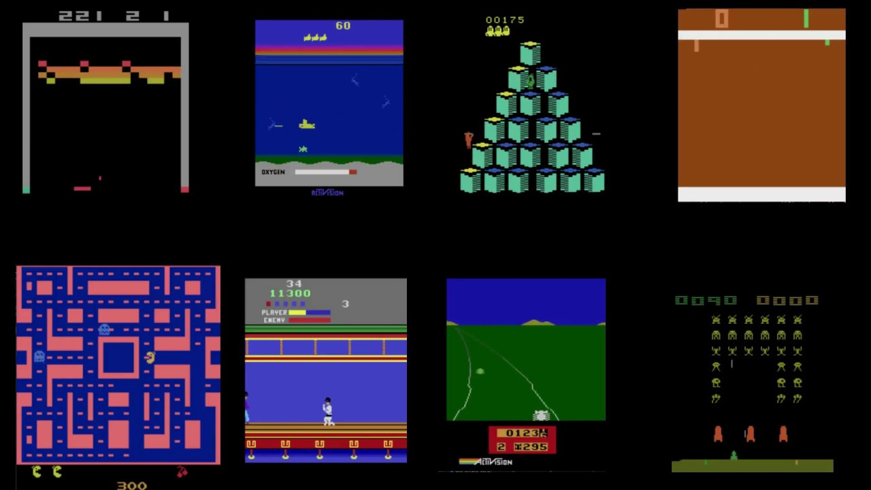
Related Works
Playing Atari with Deep Reinforcement Learning
Actor-Mimic
Schema Networks
Transfer Learning via Image-to-Image Translation
Survey

Slide 7
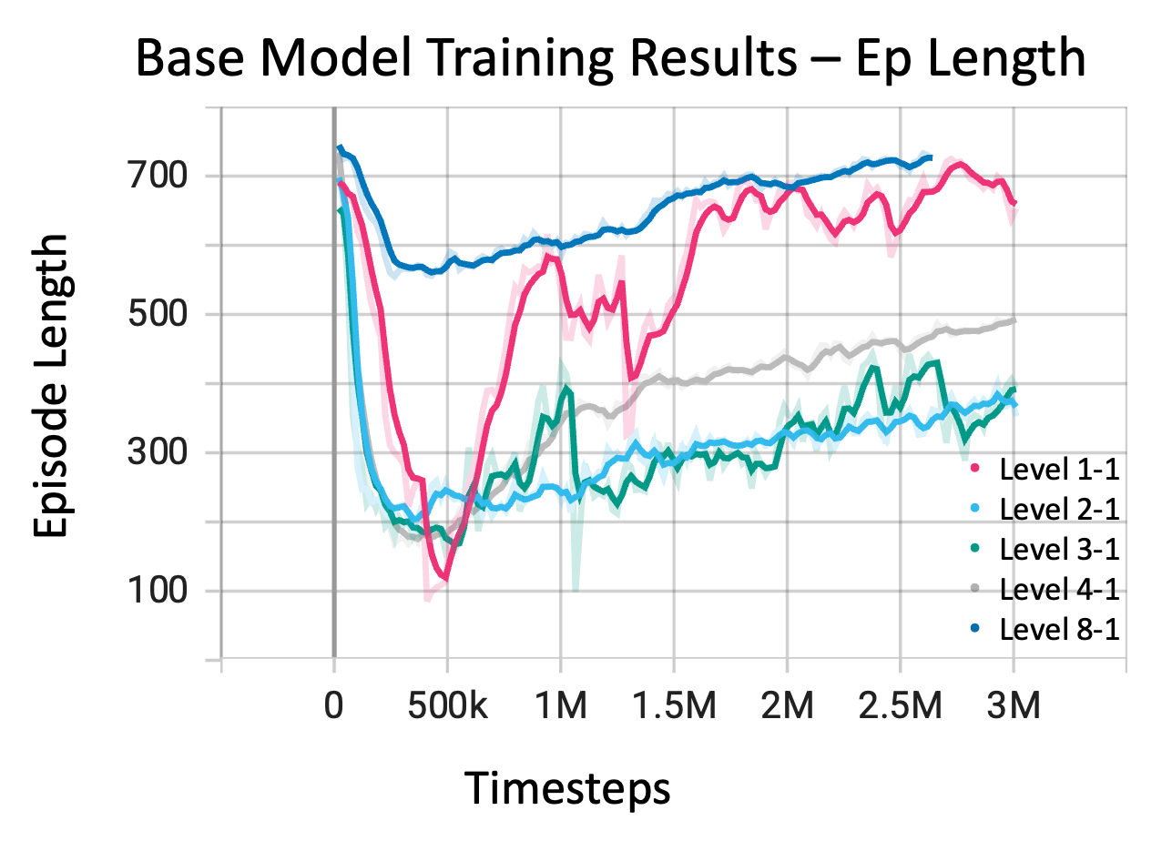
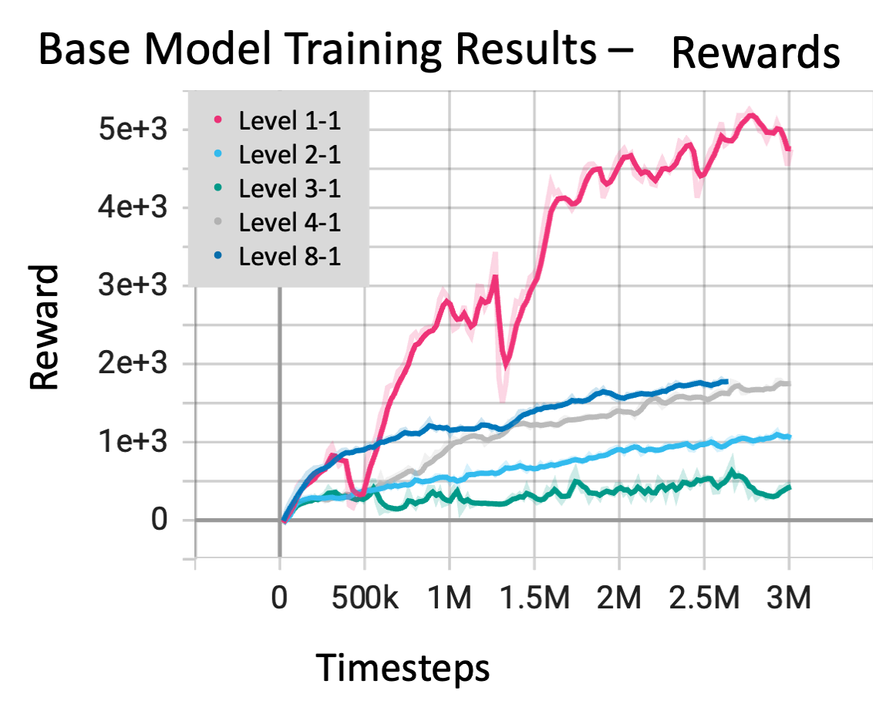
Results - Baseline

Slide 8
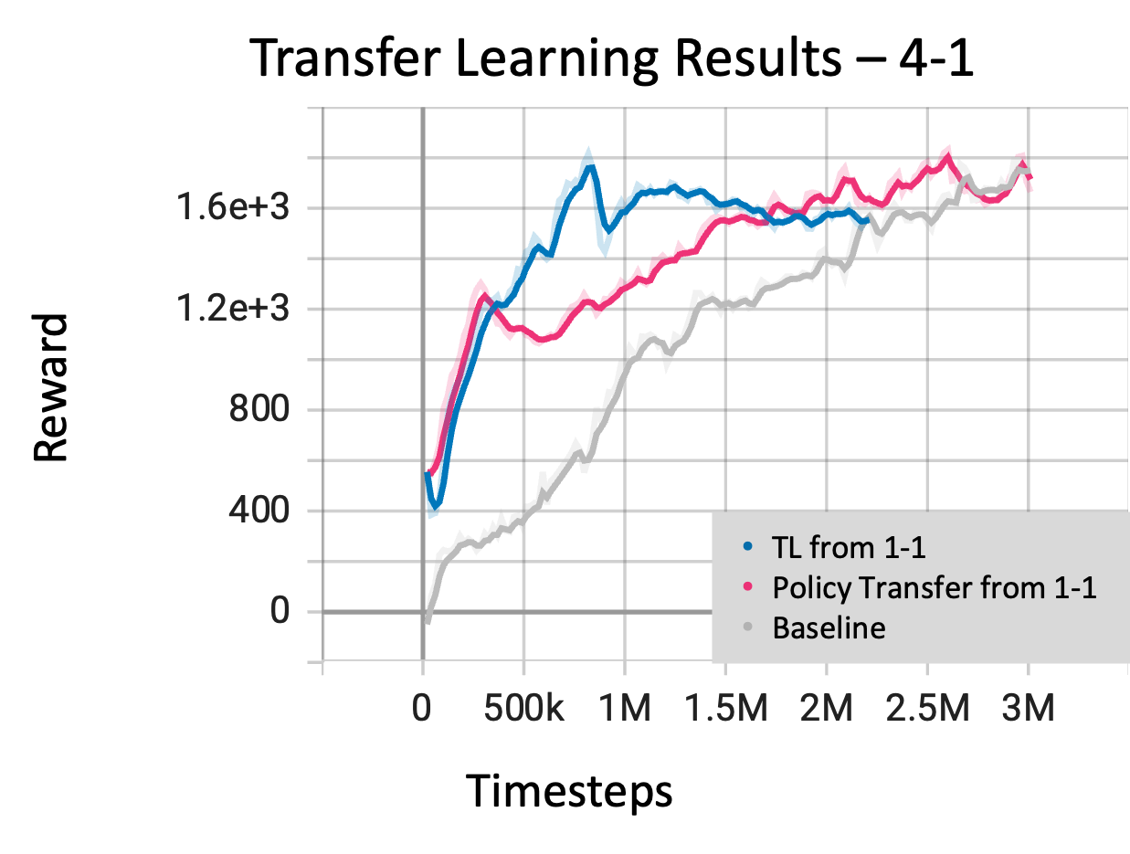
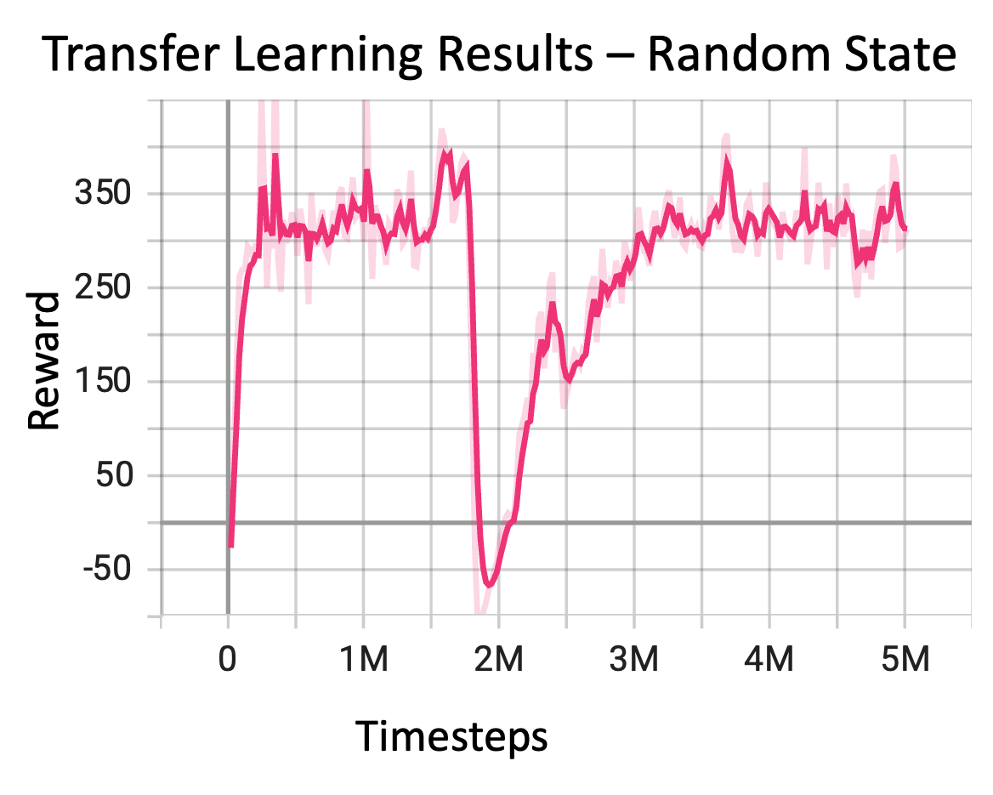
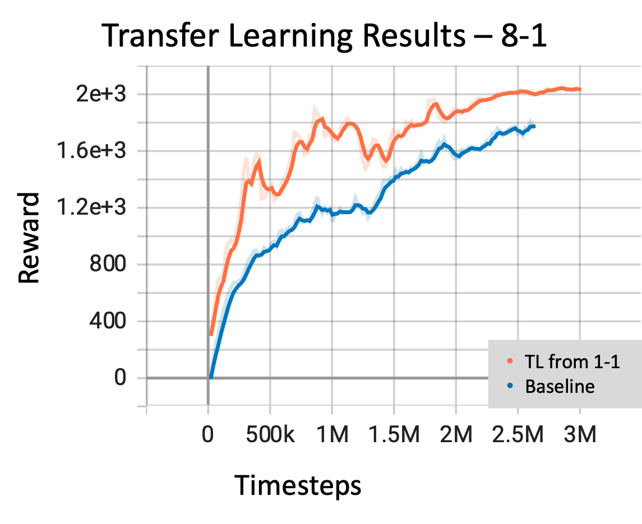
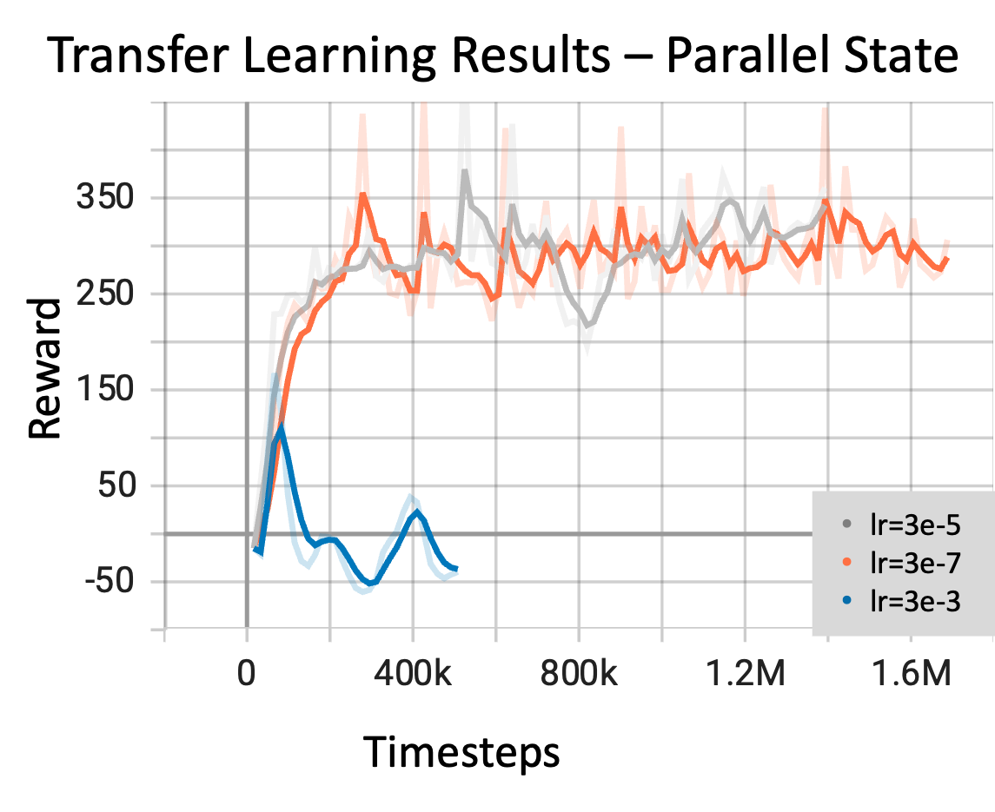
Results - Transfer Learning
Level-to-Level Transfer
Excellent early performance
Decreasing returns
Random Init
Consistently Bad
Parallel Init
More consistent

Slide 9
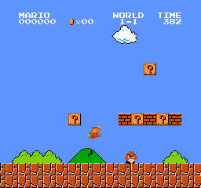
Conclusion
PPO, A2C, DQN
Transfer not held
Pre-training
Policy transfer
Future: Multi-task learning

Slide 10
Thank you!

